Slide 1
Introduction to Probability and Statistics
4CM521
The Normal Distribution

Slide 2
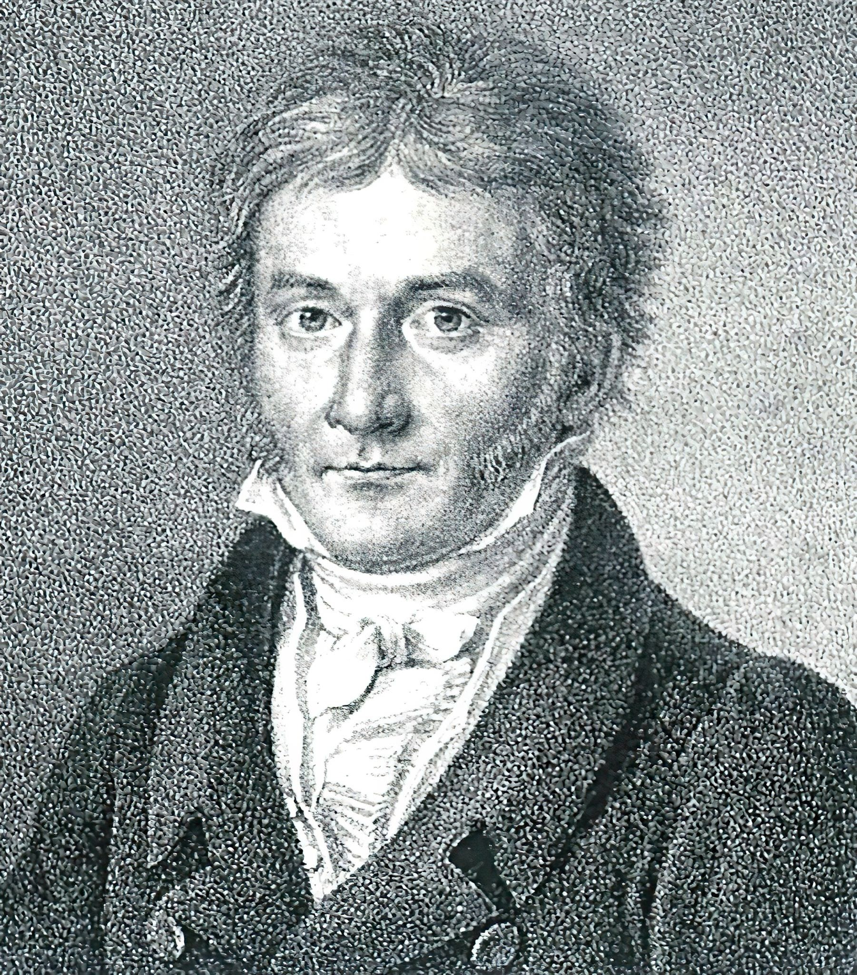
Introduction
Normal distribution is the most important continuous probability distribution which describes many phenomena that occur in nature, industry and research.
It is also known as Gaussian distribution, in honor of Karl Gauss, a German mathematician.
The normal distribution is defined by its mean (which is the peak of the distribution), and standard deviation (which determines the spread).
Most of the data from a normal distribution can be expected to lie within 3 standard deviations of the mean.

Slide 3
What variables are normally distributed?
Many averaged qualities: Rainfall, molecular velocities, football crowd attendance, test scores, women’s height etc.
Some are definitely not normal.
Key indicators are asymmetry and heavy tails: Wages, share prices, waiting times etc.

Slide 4
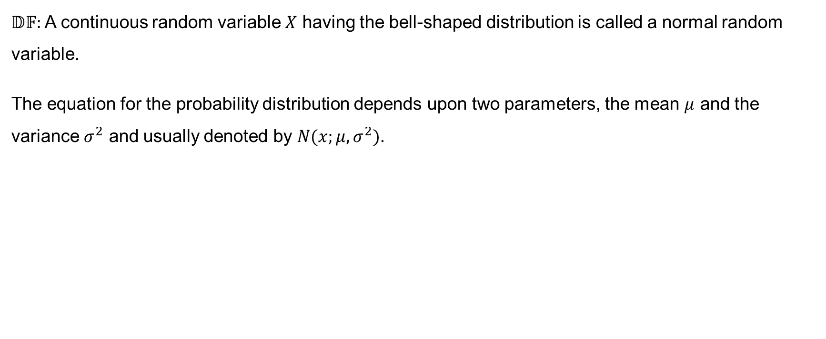
Definition
$𝔻𝔽:$ A continuous random variable $X$ having the bell-shaped distribution is called a normal random variable.
The equation for the probability distribution depends upon two parameters, the mean $μ$ and the variance $σ^{2}$ and usually denoted by $N(x;μ,σ^{2})$.

Slide 5
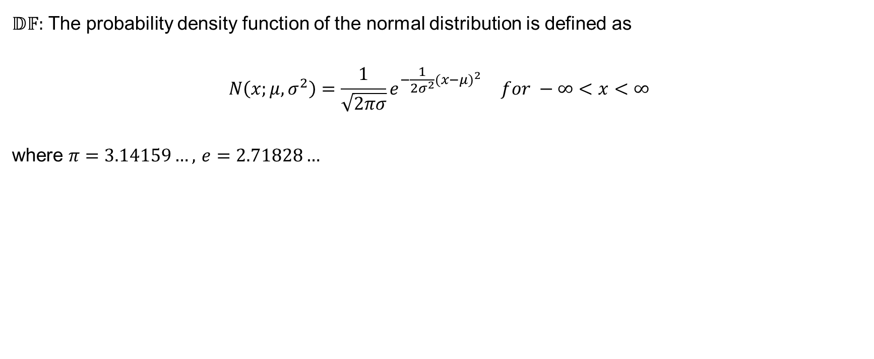
Definition (continued)
$𝔻𝔽:$ The probability density function of the normal distribution is defined as
$$N\left(x;μ,σ^{2}\right)=\begin{matrix}\frac{1}{\sqrt{2πσ}}e^{−\frac{1}{2σ^{2}}{(x−μ)}^{2}} & for −∞<x<∞\end{matrix}$$
where $π=3.14159…,$ $e=2.71828…$

Slide 6
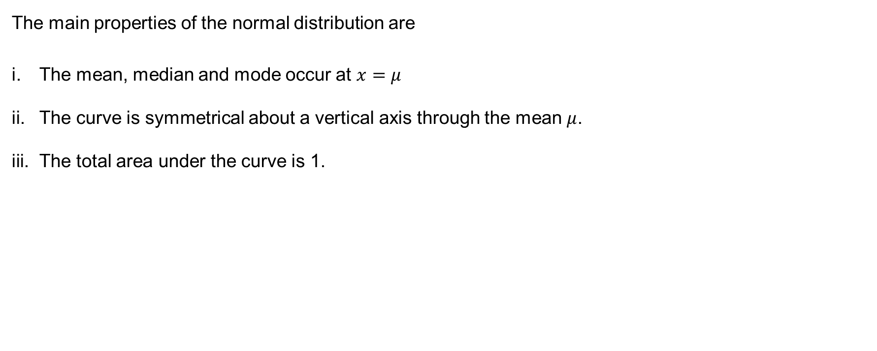
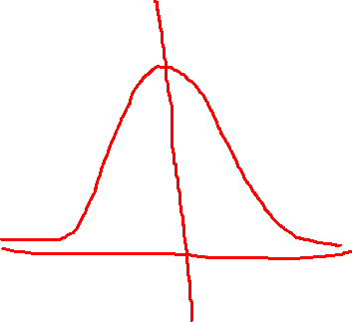
Properties of the Normal distribution
The main properties of the normal distribution are
The mean, median and mode occur at $x=μ$
The curve is symmetrical about a vertical axis through the mean $μ$.
The total area under the curve is 1.

Slide 7
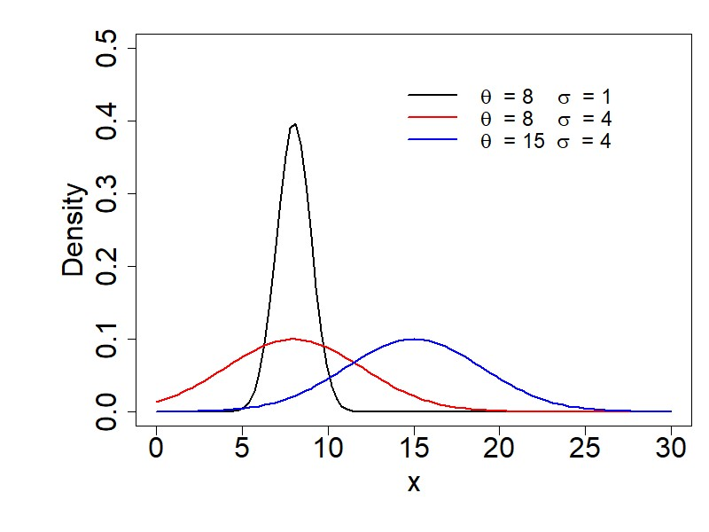


Slide 8
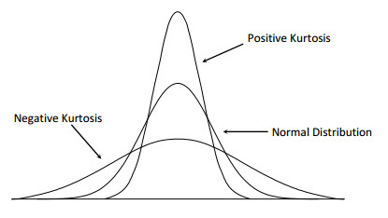
Kurtosis & the Normal distribution

Slide 9
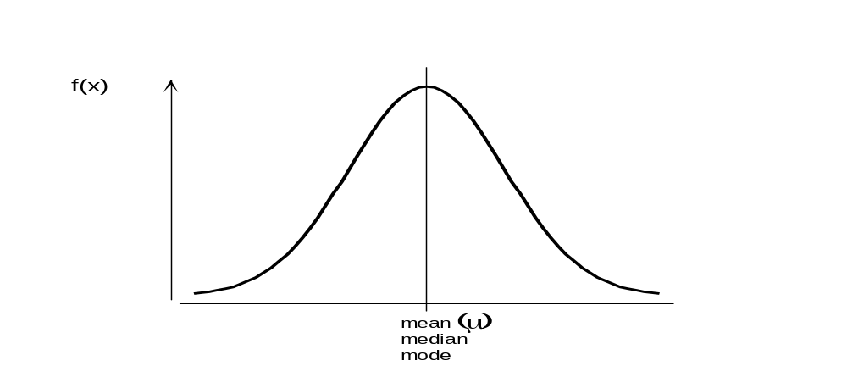
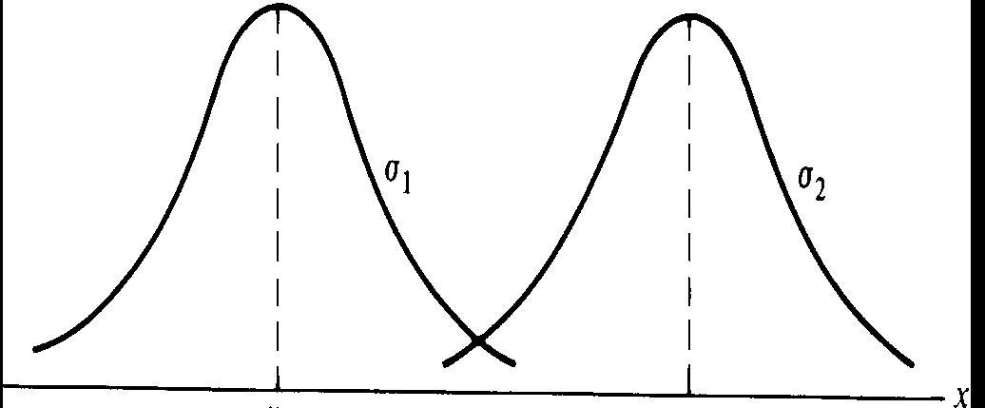
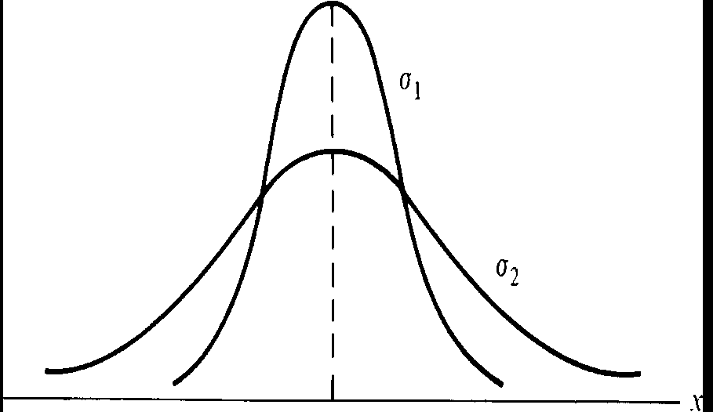
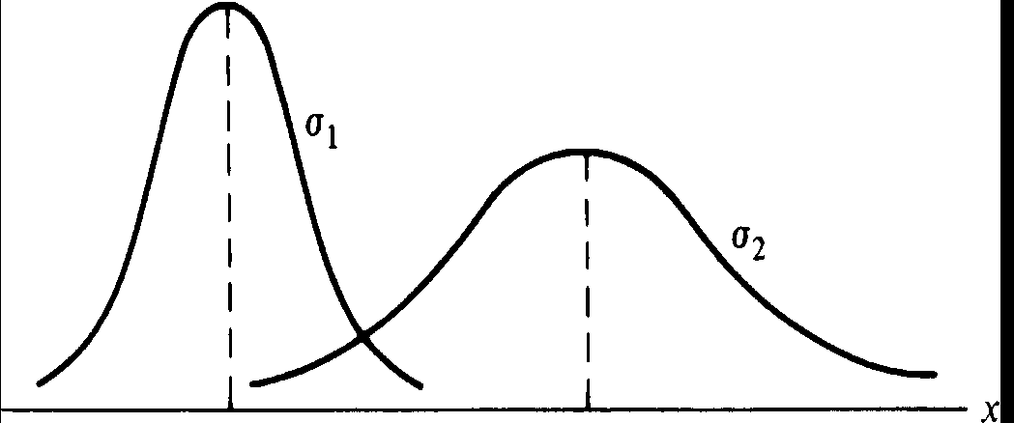
The Normal distribution and the standard deviation, σ

Slide 10
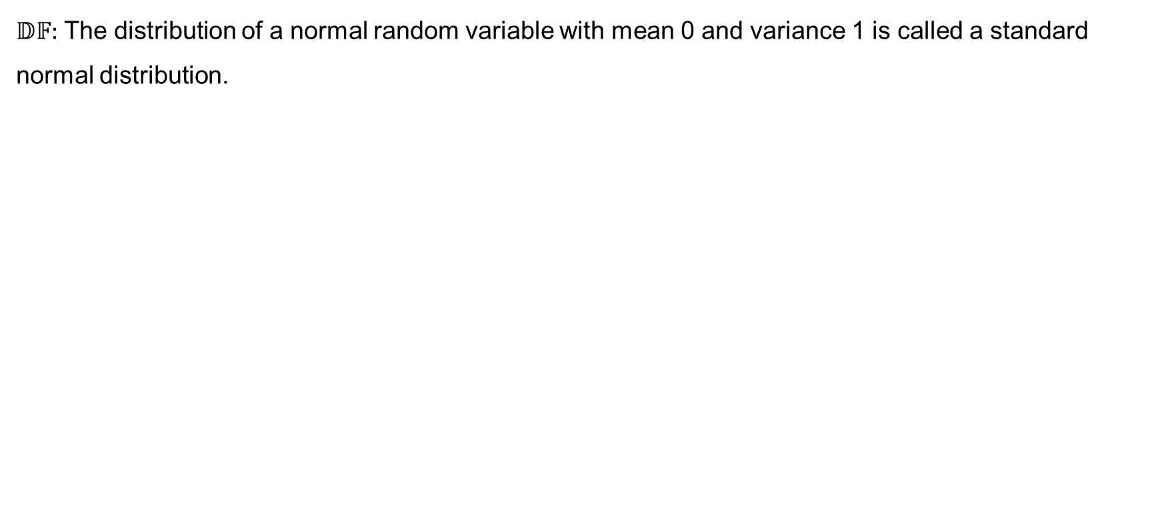
Standard Normal distribution
$𝔻𝔽:$ The distribution of a normal random variable with mean 0 and variance 1 is called a standard normal distribution.

Slide 11


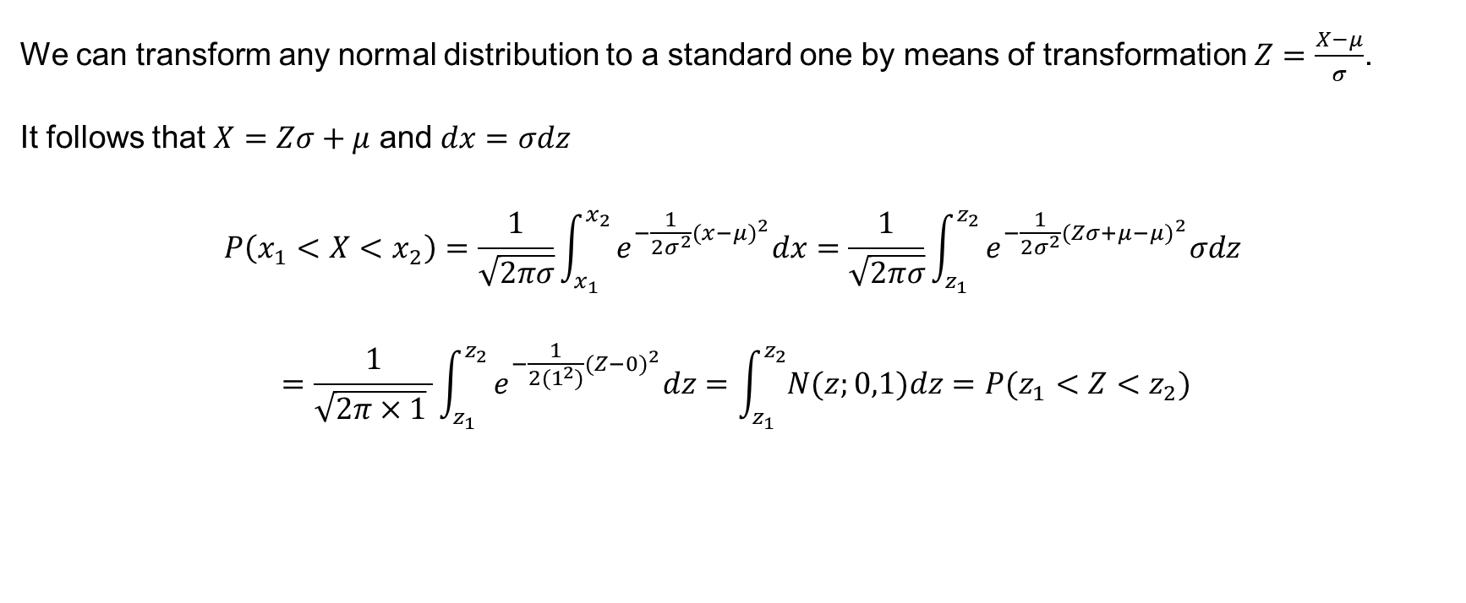




Standard Normal distribution (continued)
We can transform any normal distribution to a standard one by means of transformation $Z=\frac{X−μ}{σ}$.
It follows that $X=Zσ+μ$ and $dx=σdz$
$$P\left(x_{1}<X<x_{2}\right)=\frac{1}{\sqrt{2πσ}}\int_{x_{1}}^{x_{2}}{e^{−\frac{1}{2σ^{2}}{(x−μ)}^{2}}dx=\frac{1}{\sqrt{2πσ}}\int_{z_{1}}^{z_{2}}{e^{−\frac{1}{2σ^{2}}{(Zσ+μ−μ)}^{2}}σdz }}$$
$$=\frac{1}{\sqrt{2π×1} }\int_{z_{1}}^{z_{2}}{e^{−\frac{1}{2{(1}^{2})}{(Z−0)}^{2}}dz=\int_{z_{1}}^{z_{2}}{N(z;0,1)dz=P(z_{1}<Z<z_{2})}}$$

Slide 12
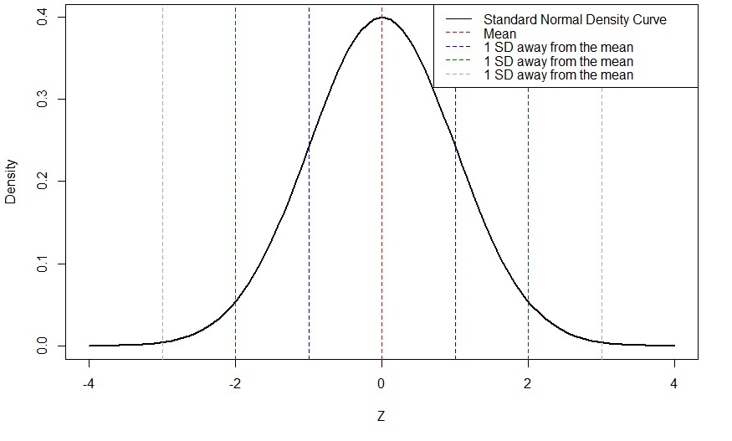


Slide 13
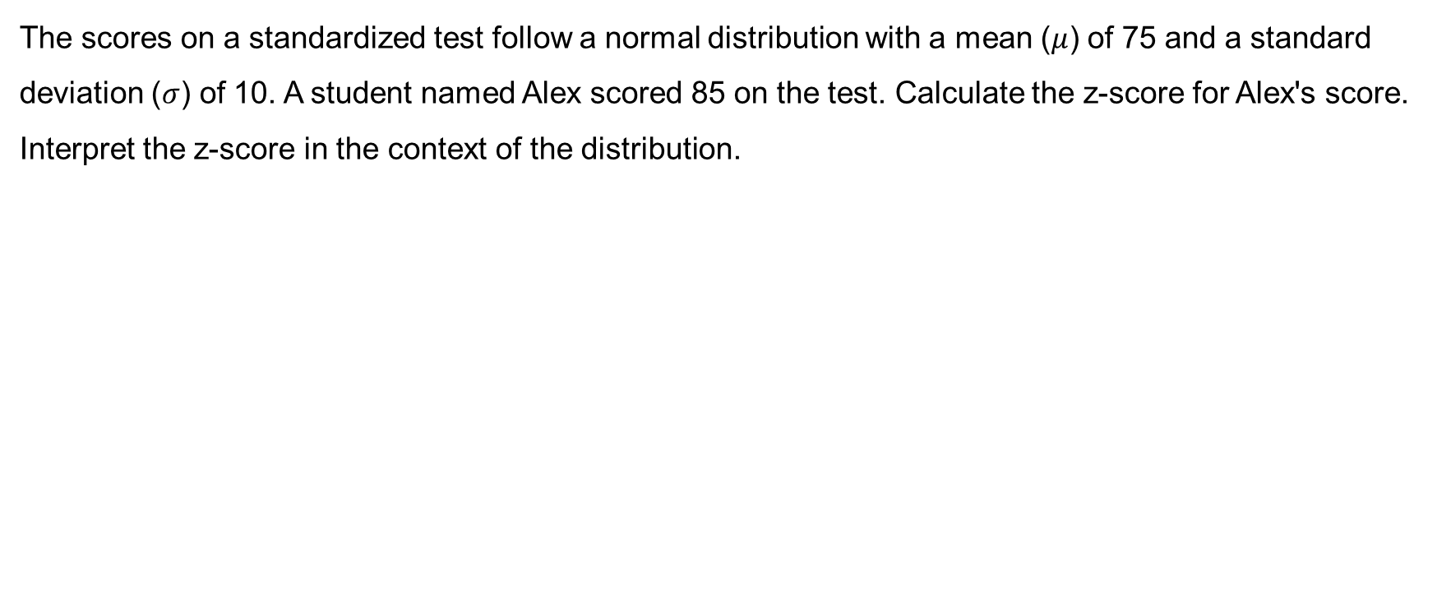
Example 8.2
The scores on a standardized test follow a normal distribution with a mean ($μ$) of 75 and a standard deviation ($σ$) of 10. A student named Alex scored 85 on the test. Calculate the z-score for Alex's score. Interpret the z-score in the context of the distribution.

Slide 14
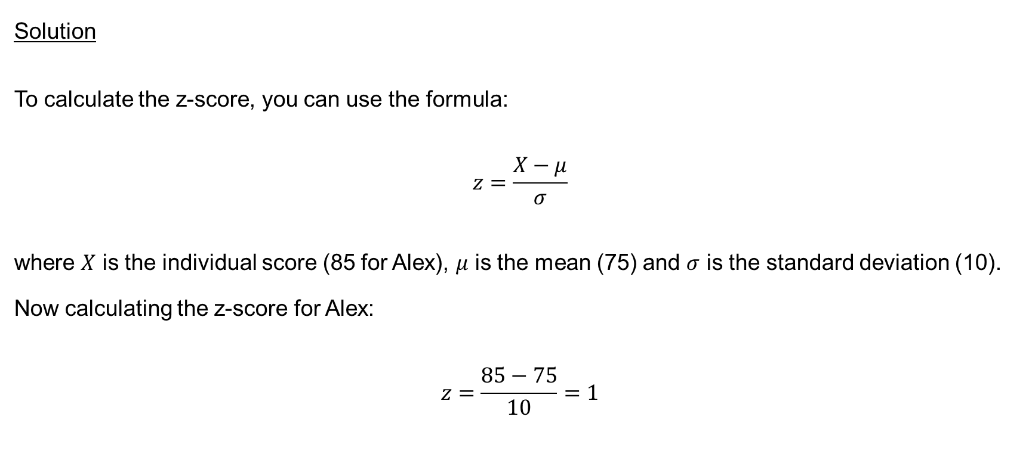
Example 8.2 (continued)
Solution
To calculate the z-score, you can use the formula:
$$z=\frac{X−μ}{σ}$$
where $X$ is the individual score (85 for Alex), $μ$ is the mean (75) and $σ$ is the standard deviation (10). Now calculating the z-score for Alex:
$$z=\frac{85−75}{10}=1$$

Slide 15
Interpretation
A z-score of 1 means that Alex's score is 1 standard deviation above the mean.
In the context of the distribution, this indicates that Alex performed relatively well compared to the average student, as his score is above the mean.

Slide 16
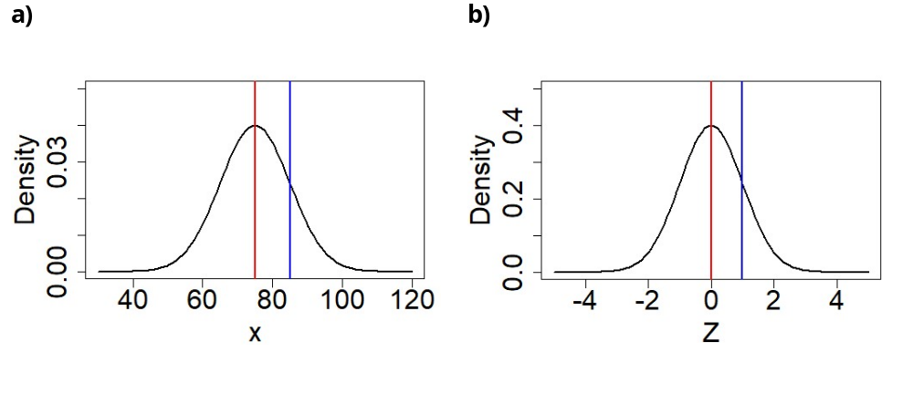

Slide 17
Summary
The Normal Distribution is amazing, mathematically beautiful and incredibly useful.
https://rexamples-golnaz.shinyapps.io/App-2/.
https://rexamples-golnaz.shinyapps.io/App-3/

